Slide 1

VELAMMAL INSTITUTE OF TECHNOLOGY DEPATMENT OF COMPUTER SCIENCE AND ENGINEERING TRIP ANALYSIS USING MODERN TICKETING
BATCH NO: A06
GUIDED BY
DR.R.SUGUMAR, M.TECH., PHD
PROFESSOR
ALEX RAAJAN A.(113315104006)
ARAVINDH B.(113315104012)
SANTHOSH KUMAR M.(113315104072)

Slide 2
OVERVIEW
OBJECTIVE
ABSTRACT
INTRODUCTION
LITERATURE SURVEY
EXISTING SYSTEM
PROPOSED SYSTEM
SYSTEM ARCHITECTURE
MODULES
SYSTEM REQUIREMENTS
CONCLUSION
FUTURE ENHANCEMENT
REFERENCE

Slide 3
OBJECTIVE
The Bus is one of the widely used public transport in many cities. In improving the quality of bus service, a real-time system can be formulated that can monitor and predict the passenger flow of the running bus is helpful.
The passenger flow that is denoted here is the number of on-board passengers of a bus, this varies over time and space. This passenger flow can partially reflect the sum of human mobility along a particular route and the quality of bus service in term of comfort. In the perspective of scheduling, it tells us how many people travel or want to travel on a route.
These information can guide the administrator to allocate and schedule the bus route and timetable dynamically in fine granularity. The use of automated data-collection systems grow rapidly and show great potential. Automatic Fare Collection (AFC) devices that can record payments of riders using QR based system, and a GPS embedded in the mobile device that can track the bus are widely deployed.
With the mature of big data systems, we have the opportunity to estimate and predict the passenger flow of every bus in urban wide Bus Transit System (BTS).

Slide 4
ABSTRACT
In this digital era all the traditional systems have been modernized using the current technologies. Public transport is one of the highly used medium of travel in major cities.
The study in 2018 states that on an average the public bus carries 1300 passengers per day in Chennai(India) .The existing system does provide monitoring and analysing methods for these data’s generated.
This has paved way in proposing an efficient digital solution for monitoring and analysing the data in this field. To provide a comfortable travel experience, effective bus scheduling is essential. Traditional approaches are based on fixed timetables.
The wide adoptions of QR base fare collection systems in public transportation provide new opportunities for using the data-driven approaches to fit the demand of passengers.
This system is being associated with these two independent data sets to derive the passengers’ origin and destination. As the data are real time, a system is built to forecast the passenger flow in real time. To the best, this is the project, which implements a system utilizing QR system forecast the passenger flow in real time.
KEYWORDS— Digital-era, Real-time, QR fare collection, estimation, prediction.

Slide 5
LITERATURE SURVEY
TITLE & AUTHOR | DESCRIPTION | ADVANTAGE | DISADVANTAGE
The research and implementation of GPS intelligent transmission strategy based on on-board Android smartphones. Z. Wei, Y. Song, H. Liu, Y. Sheng, X. Wang. 2013 3rd International conference on computer science and network technology. | Smartphones have been widely integrated with GPS receiver, which may provide accurate location information of vehicles without cost increase. | we implemented a platform to collect real-time GPS data from vehicles. | The central server was in a fixed frequency that it cannot be updated dynamically
Performance evaluation of IoT protocols under a constrained wireless access network. Y. Chen, T. Kunz. 2016 International conference on selected topics in mobile & wireless networking. | Internet of Things (IoT) is to efficiently support machine-to-machine communication, given that the remote sensors and the gateway devices are connected through low bandwidth, unreliable, or intermittent wireless communication links. | Its superior performance with regard to data latency and reliability makes it an attractive choice for medical IoT applications and beyond. | There was a high packet loss in this type of communication.

Slide 6
LITERATURE SURVEY (continued)
TITLE & AUTHOR | DISCRIPTION | ADVANTAGE | DISADVANTAGE
Implementation of unconscious bus location sensing system with smartphone devices and beacon devices. K. Tanaka, K. Naito. 2016 13th IEEE annual consumer communication & networking conference. | The beacon device is used to get the location of the bus and store it in a cloud service. | The new participatory sensing mechanism will help in location effectively. | The beacon device is attached with the smartphone such that both should be active in order give the result effectively.
Hybrid dynamic prediction model of bus arrival time based on weighted of historical and real-time GPS data. J. Gong, M. Liu, S. Zhang 2013 25th Chinese control and decision conference. | Global positioning system-based automatic vehicle location (AVL) systems have been adopted by many transit agencies for tracking their vehicles and predicting travel time in real time. | The automatic vehicle location will help in predicting the travel time. | The automatic positioning is related with the hardware used to do the process.

Slide 7
LITERATURE SURVEY (continued)
AUTHOR & TITLE | DISCRIPTION | ADVANTAGE | DISADVANTAGE
GPS based bus tracking system. L. Singla, P. Bhatia. 2015 International conference on computer communication and control. | People who rely on the public transport their major concern is to know the real time location of the bus for which they are waiting for and the time it will take to reach their bus stop. This information helps people in making better travelling decisions. | The real time location of the public transport, is formulated effectively. | The notification is done with GSM module which is slow and not effective.
RFID-based Ticketing for Public Transport System: Perspective Megacity Dhaka. Foisal Mahedi Hasan et al 2010 3rd International Conference on Computer Science and Information Technology. | This paper actually suggests a much more public friendly, automated system of ticketing as well as the credit transaction with the use of RFID based tickets. | The total system mainly acts to bring out the consistency among various bus agencies that will conclude in uniform access of passengers in daily rides through an automated server being updated every single time the passengers travel by carrying the RFID based tickets. | Hardware debugging is the major problem. We fabricated all the components in PCB and test power supply; input and output. If the ports are not working then check the code and rework in hardware.

Slide 8
EXISTING SYSTEM
Current practice in Bus Transit System (BTS) operators demonstrates that manual data-collection efforts are costly and usually applicable only in small scale.
In Existing system RFID Reader is used to read the RFID tag but destination should be entered by passenger in keyboard , So that amount will be debited automatically from the tag.
Here if once destination is arrived, bus stops automatically and intimate with buzzer sound. Fairly such arrangement consumes more time in case of accessing of tag by every individual, so to overcome that, implementation of ticketing system without access is developed in this proposal with addition of application to transfer information about accident occurrence.
Disadvantage:
Hardware debugging is the major problem.
We fabricated all the components in PCB and test power supply; input and output.
If the ports are not working then check the code and rework in hardware.

Slide 9
PROPOSED SYSTEM
The proposed system, introduces a digital payment method for collecting the ticketing data’s efficiently, for making this happen the proposed system implements a QR based payment methodology for a convenient user interface.
To implement the proposed system an android application is used for selecting the travelling route and to generate amount.
The generated amount will be processed through QR image system. An automatic update in the financial status will be done in bank as well as the wallet.
All the data’s generated will be stored in the database for analyses purpose. Then the user will be confirmed with the SMS message about the travelling ticket details.
With the gathered data’s the admin will do the analysis and will find the peak timings, the overflow of bus in a particular route, insufficient bus in a particular route. This will allow the organization to run in a effective way.

Slide 10
ADVANTAGE
DISADVANTAGE
No complicated hardware training required to handle this system.
The problem of inadequate change will be rectified with this system.
The analysis in bus routes can be effective so that, it helps in improving the wastage of fuel.
The QR image should be accessible to all the passengers.
The security measures are to taken into serious considerations.
The system should be flexible to the fast changing technology.

Slide 11
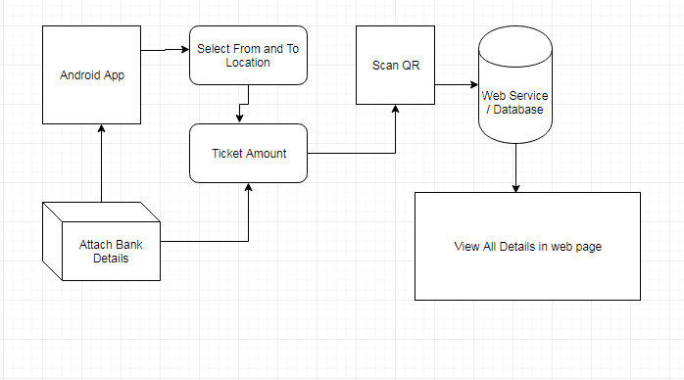
SYSTEM ARCHITACTURE

Slide 12

ALGORITHM
SVM( Support Vector Machine):
More formally, a support vector machine constructs a hyperplane or set of hyperplanes in a high- or infinite-dimensional space, which can be used for classification, regression, or other tasks like outliers detection. Intuitively, a good separation is achieved by the hyperplane that has the largest distance to the nearest training-data point of any class (so-called functional margin), since in general the larger the margin the lower the generalization error of the classifier.

Slide 13
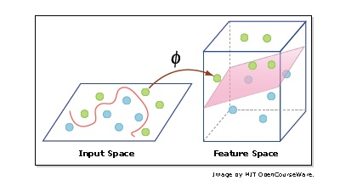
ALGORITHM (continue)
Kernel:
Kernel methods are a class of algorithms for pattern analysis, whose best known member is the support vector machine (SVM).
In its simplest form, the kernel trick means transforming data into another dimension that has a clear dividing margin between classes of data.

Slide 14
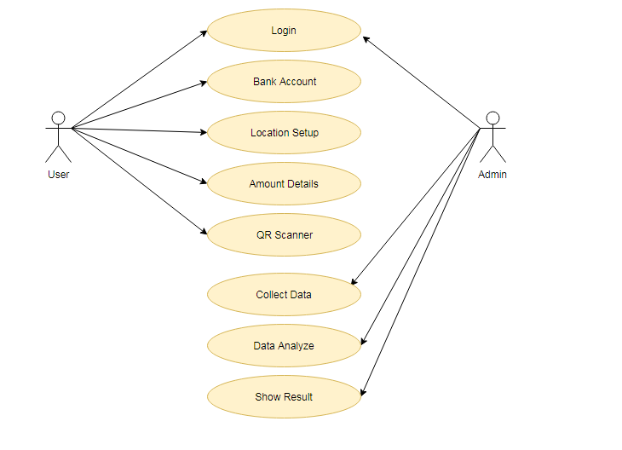
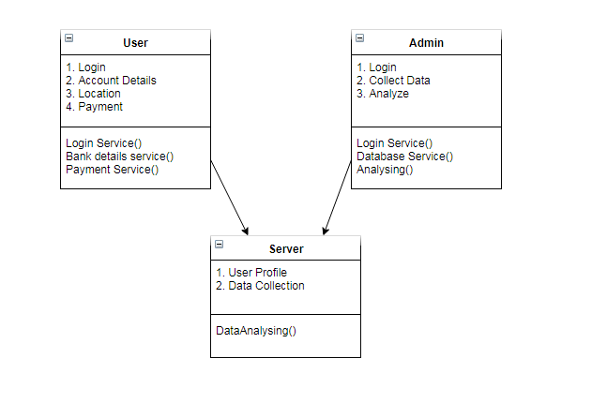
UML DIAGRAM
Use Case Diagram:
Class Diagram:

Slide 15
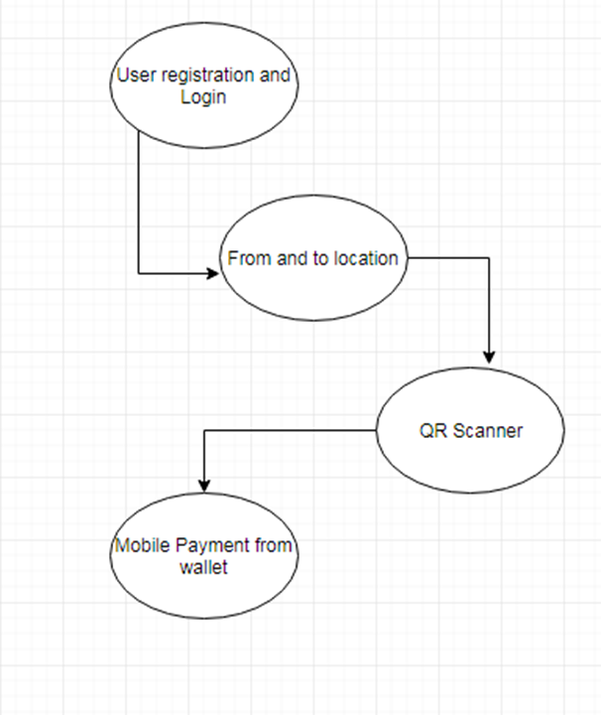
ER DIAGRAM
UML DIAGRAM (continued)
DATA FLOW DIAGRAM
User
Admin
QR Scanner
Login/
registration
Login/registration
Amount details
Show Result
Collect data
Bank Account
Location setup
Data Analyze

Slide 16
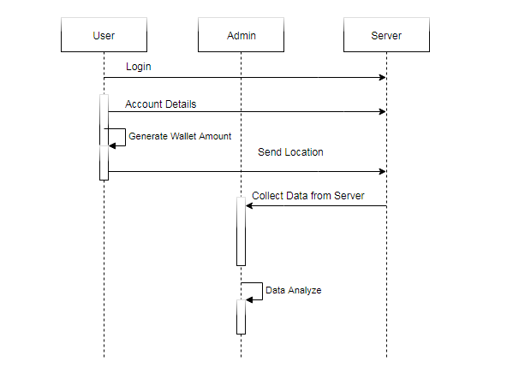
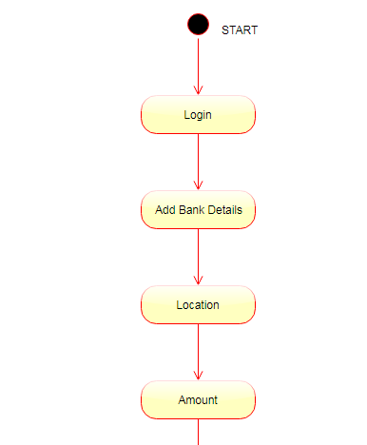
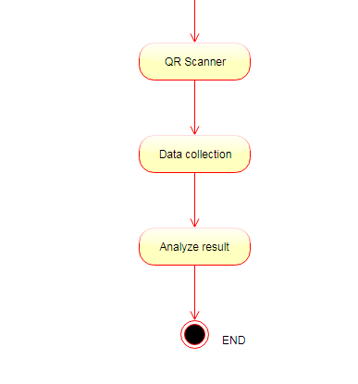
UML DIAGRAM (continued)
Sequence Diagram:
Activity Diagram:

Slide 17
MODULES
User registration
Location Selection
QR Payment Gateway
Database
Classification

Slide 18
MODULES (continued)
User registration
An android application for the user’s are created. The user can register them in this application along with their bank details. The bank details that are been registered will be helpful in processing the QR fire collection system. The bank details given by the user will be verified with the help of OPT to the registered mobile number.
Location Selection:
This module will gather information about the starting and ending location. Based on this location and the head count provided by the user the algorithm will generate the fare details. Then the payment process can be processed through the QR system.

Slide 19
MODULES (continued)
QR Payment Gateway
When all the required details are been gathered to generate the fare amount then the next step is the payment gateway. A QR image is been used to do so, this image will have the details to the amount need to be sent. With a scan the amount can be sent an acknowledgement will be received. we are using SOAP protocol, it will collect all the details from android application and it will send to server.
Database
The data’s that are stored in the database can be viewed by the administrator , this will include all the information regarding the head count in a particular route. With this the analysis will take place in order to find out the overflowing and insufficient buses in a particular route.

Slide 20
MODULES (continued)
Classification
The classification can be done on the basis of 3 hours using SVM algorithm. The data that are been gathered are in regards with the users processing the QR payment gateway. This data is been used to analyze the effectiveness of public transport in a particular route.

Slide 21
SYSTEM REQUIREMENTS
HARDWARE
SOFTWARE
OS – Windows 7,8,10
RAM – Min 4GB
Android Mobile
JDK
Android Eclipse (ADT-Bundle)
Net beans IDE
Mysql

Slide 22
SYSTEM REQUIREMENTS (continued)
Functional Requirements
Function_1: User Registration:
Purpose: The purpose of registration is to attach all the images of the moves of unauthorized intruder.
Inputs: The user will enter details in the registration form according to required fields, some of the fields include are username, password, confirm password, first name etc
Processing: On the server side the servlet is used to capture the details of the user and then store the details in the database.
Output: After the registration the user will be directed to the main home
Error Handling : If error is encountered than try to handle it with some suitable exception handling method

Slide 23
SYSTEM REQUIREMENTS (continued)
Non-Functional Requirements
Some of the non-functional requirements are as follows:
1. Performance-is high as only it gets processed when necessary.
2. Reliability – is high as only registered users will get the intruder’s images.
3. Security- It provides security to the data by authentication, only those users who are registered can access.
4. Portability-SISME-HSS is a real time project which can be implemented on any system which supports the requirements.
5. Logical Database Requirements – data base is needed for storing the details of the users and images.

Slide 24
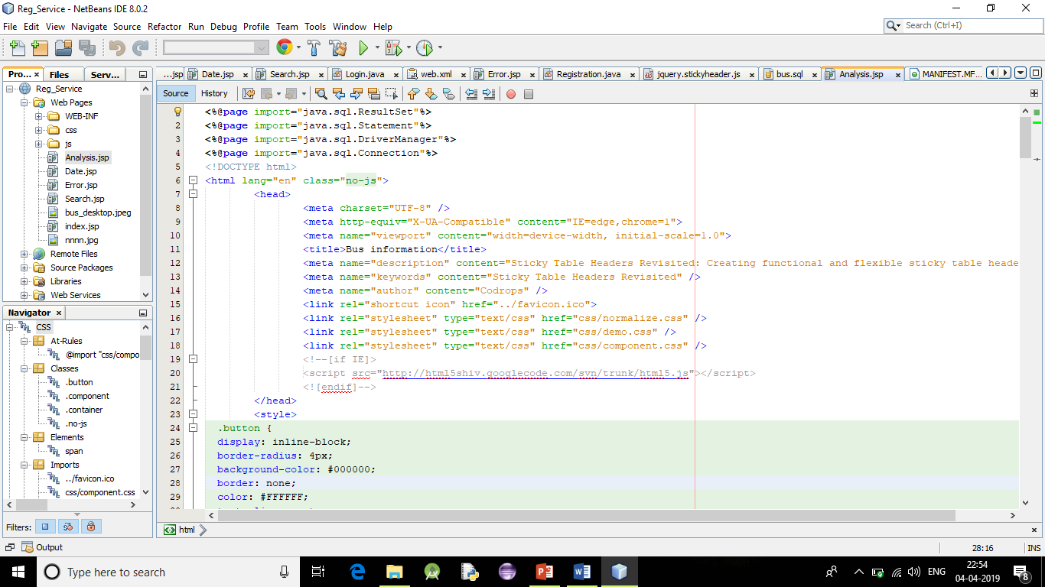
SCREENSHOT

Slide 25
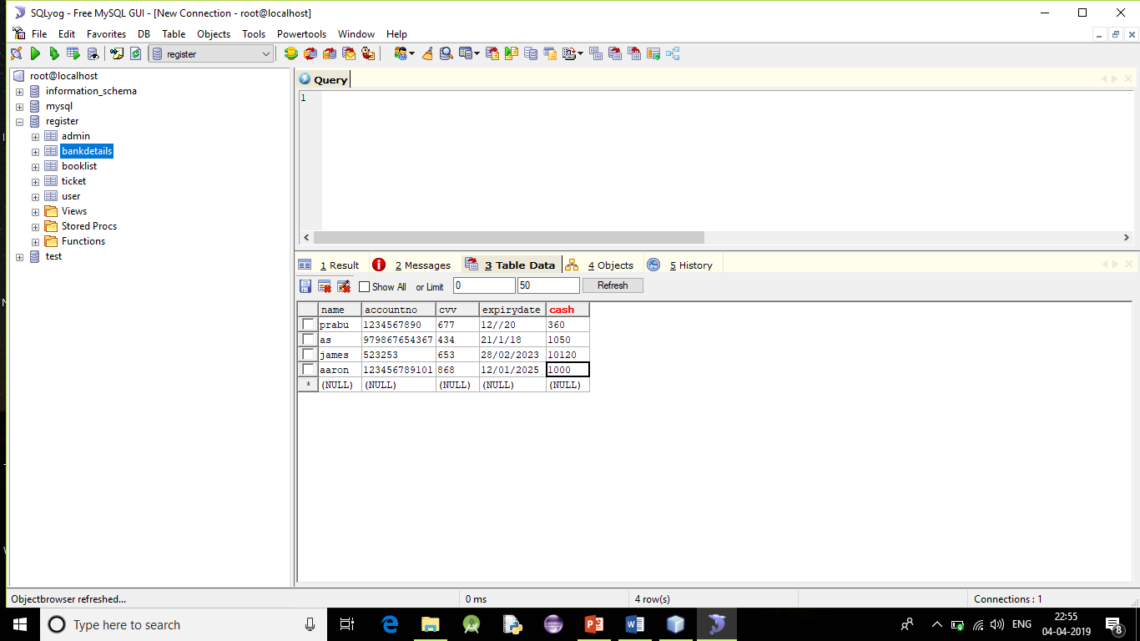
SCREENSHOT (continued)

Slide 26
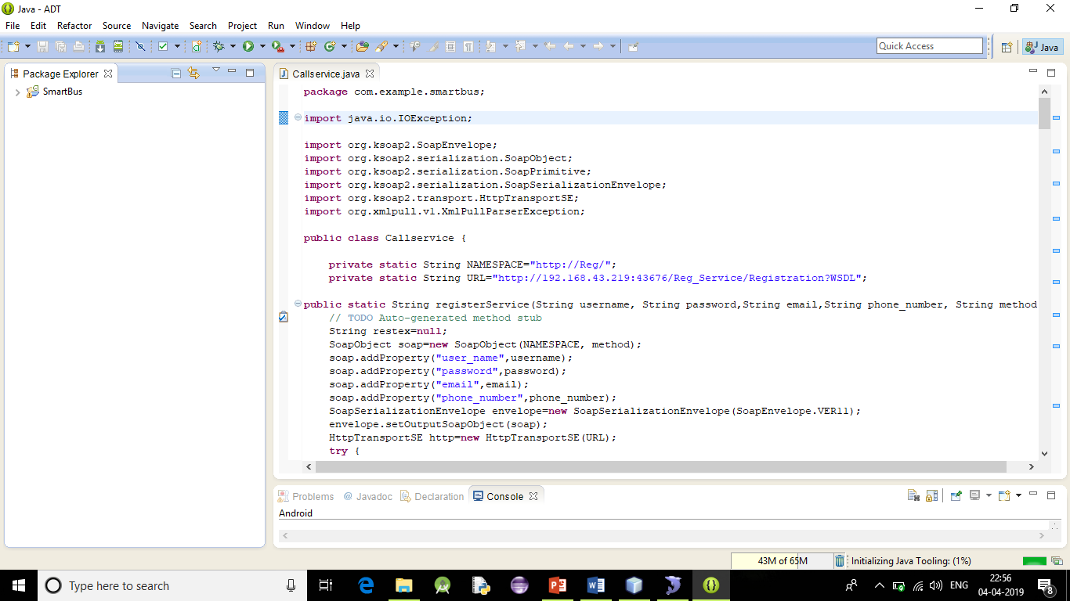
SCREENSHOT (continued)

Slide 27
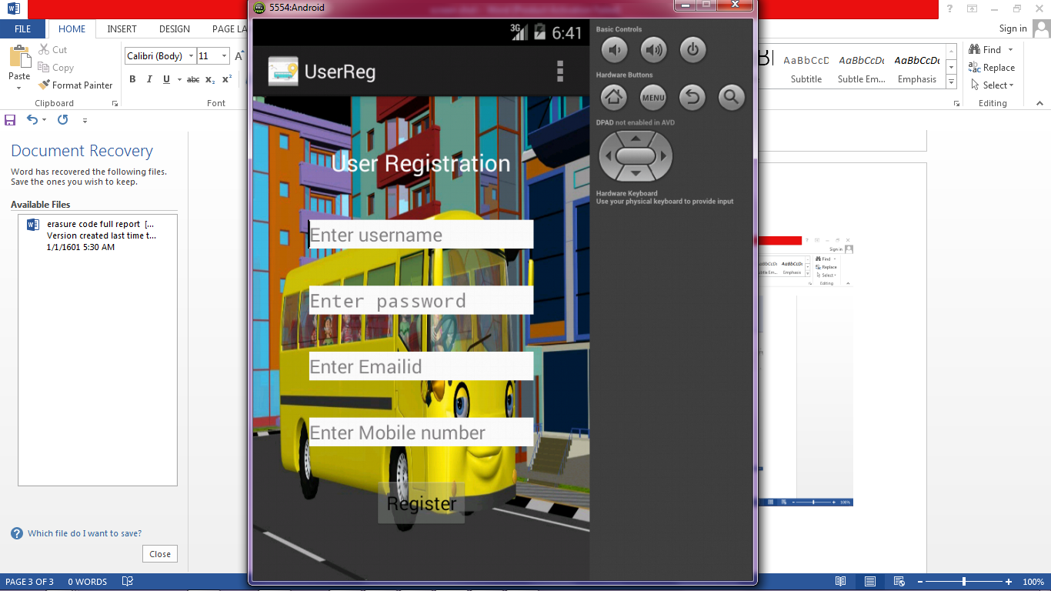
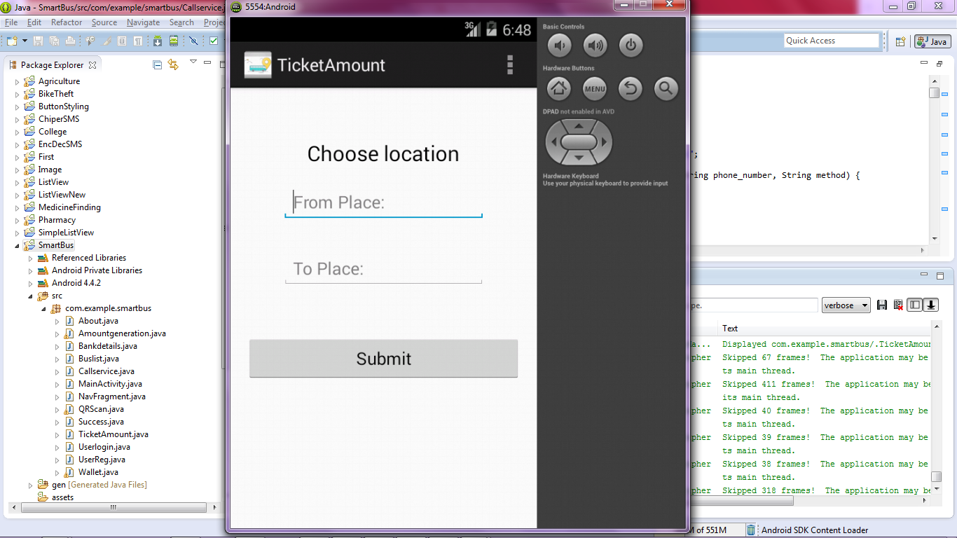
SCREENSHOT (continued)

Slide 28
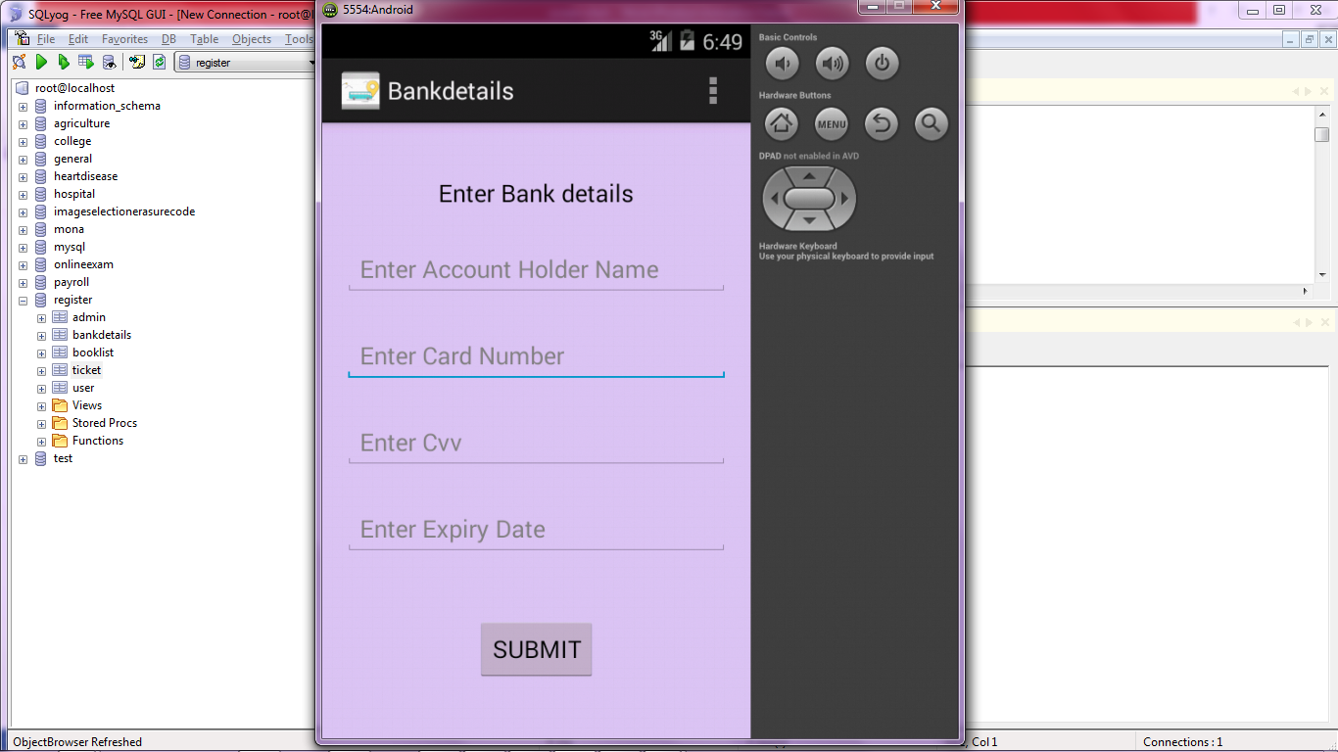
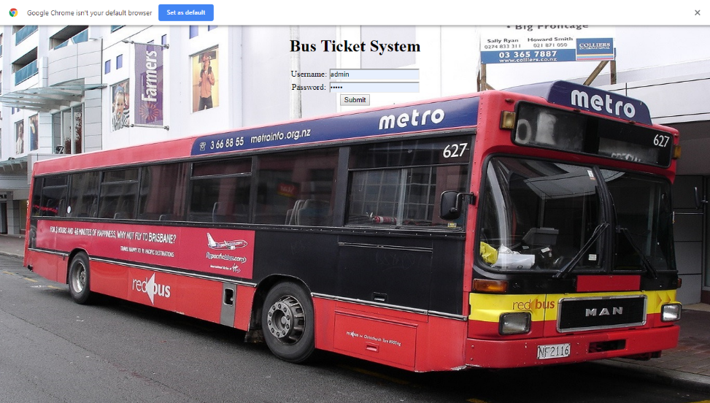
SCREENSHOT (continued)

Slide 29
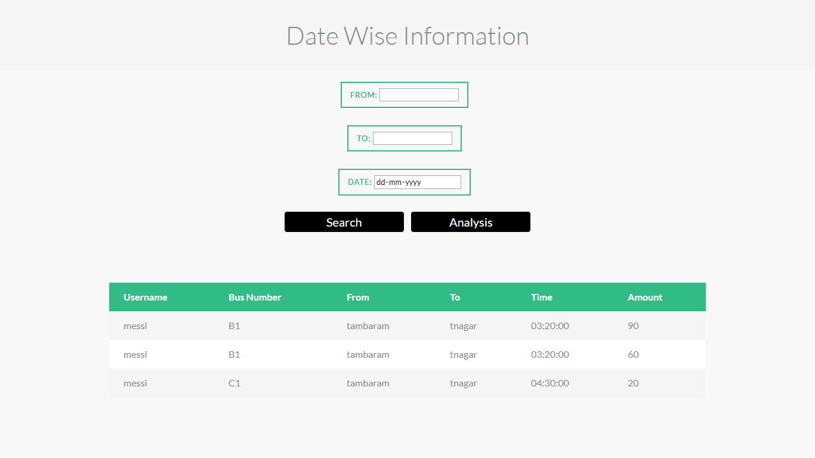
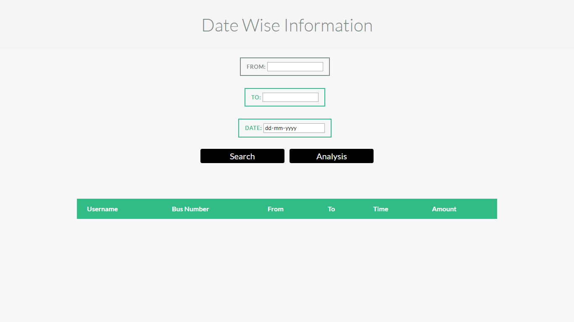
SCREENSHOT (continued)

Slide 30
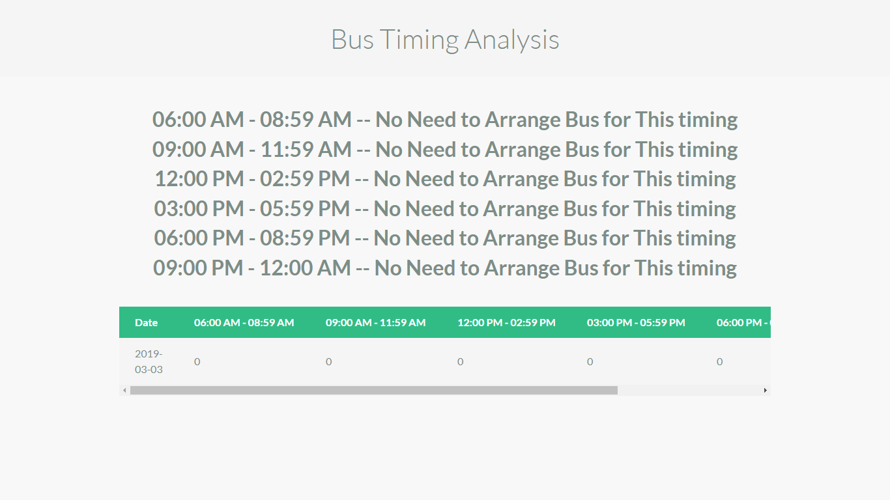
CONCLUSION
This project proposes an effective way in collecting and utilizing the ticketing data’s that is generated in public transport.
This efficient method of analysing data can allow the administrator to organize and understand about the detailed transportation module.
Thus it results in providing a better model of organization. The challenge is mainly inculcated in gathering the data’s of the passengers and that is sorted using QR system. The implementation of the proposed system can be done in a large scale provided sufficient network facility.

Slide 31
FUTURE ENHANCEMENT
The project is aimed in providing a complete user friendly and administrational friendly public transportation system.
As of now this project deals from the administrative perspective and not completely on the user perspective.
The future enhancement can be made by implementing a live GPS tracking in the public transport and also to communicate the current head count of passengers in the public transport.
There is a good scope for all the future enhancement that are made in providing the public transportation digital.

Slide 32
REFERENCE
Tarciso Braz , Matheus Maciel, Demetrio Gomes Mestre, Nazareno Andrade, Carlos Eduardo Pires, Andreza Raquel Queiroz, and Veruska Borges Santos. “Estimating Inefﬁciency in Bus Trip Choices from a User Perspective With Schedule, Positioning, and Ticketing Data”. IEEE TRANSACTIONS ON INTELLIGENT TRANSPORTATION SYSTEMS 2018.
Yuqiao Cheng, Zhengxin Fu, Bin Yu. “Improved Visual Secret Sharing Scheme for QR Code Applications”. IEEE Transactions on Information Forensics and Security 2018.
Jun Zhang, Dayong Shen, Lai Tu, Fan Zhang, Chengzhong Xu, Yi Wang, Chen Tian, Xiangyang Li, Fellow, IEEE, Benxiong Huang, and Zhengxi Li. “A Real-Time Passenger Flow Estimation and Prediction Method for Urban Bus Transit Systems”. IEEE TRANSACTIONS ON INTELLIGENT TRANSPORTATION SYSTEMS 2017.
R. Nair, C. Coffey, F. Pinelli, and F. Calabrese, “Large-scale transit schedule coordination based on journey planner requests,” Transp. Res. Rec., J. Transp. Res. Board, vol. 2351, pp. 65–75, Dec. 2013.
https://en.wikipedia.org/wiki/Web_service.
Tkachenko, W. Puech, C. Destruel, et al., “Two-Level QR Code for Private Message Sharing and Document Authentication,” IEEE Transactions on Information Forensics & Security, vol. 11, no. 13, pp. 571-583, 2016.
J. Jung and K. Sohn, “Deep-learning architecture to forecast destinations of bus passengers from entry-only smart-card data,” IET Intell. Transp. Syst., vol. 11, no. 6, pp. 334–339, Aug. 2017.

Slide 33
Publication (Conference & Journal)
AUTHORS:
Dr. R. Sugumar , Alex Raajan A. , Aravindh B. , Santhosh Kumar M.
TITLE:
Trip Analysis Using Modern Ticketing
JOURNAL:
International Journal Of Innovative Research In Science, Engineering And Technology (IJIRSET)
Website: www.ijirset.com
Volume 8, Special Issue 2, March 2019
CONFERENCE: 7th National Conference On Computer Communication & Information Technology
Organized By: T.J.S Engineering College
Held On: 13th March 2019

Slide 34
THANKYOU

